Slide 1
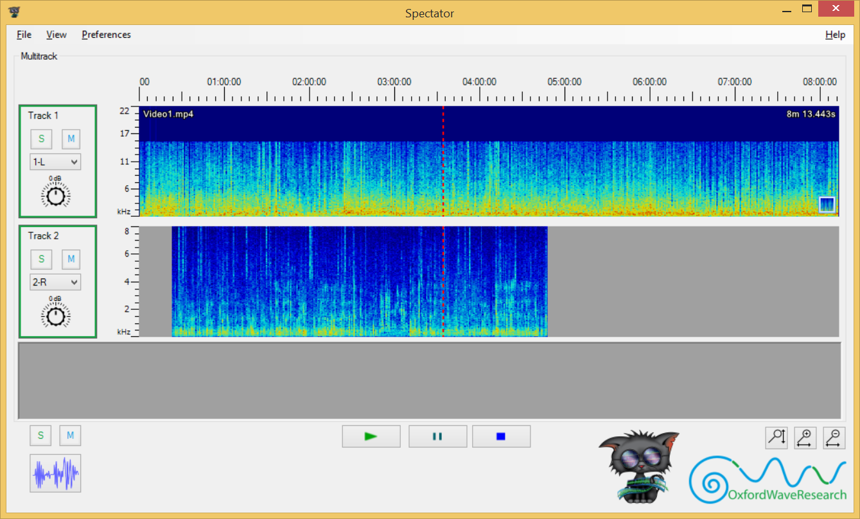
1
7
2
9
6
11
3
10
4
5
8
12
14
16
13
17
15

Slide 2
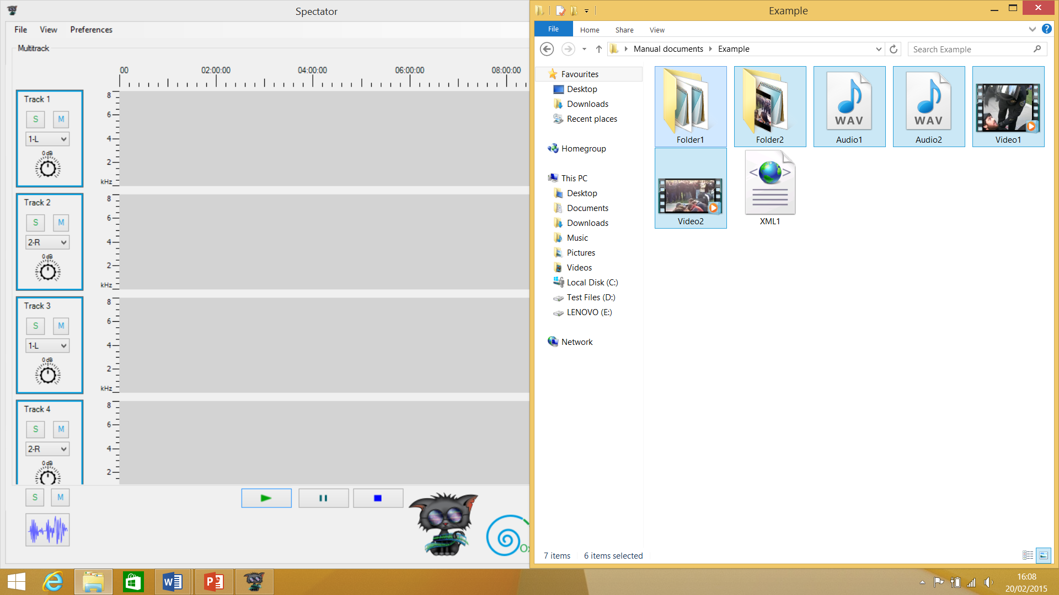
Drag a MadCat exported XML, or media files (or folders containing them) into Spectator.

Slide 3
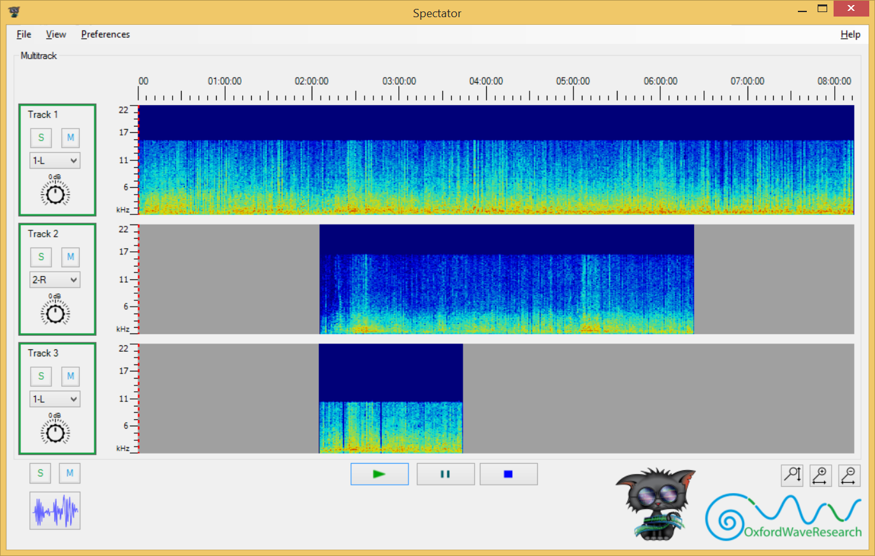
Once all tracks have loaded, you can control playback for all tracks with the bottom controls, or individual tracks using the side control panels.

Slide 4
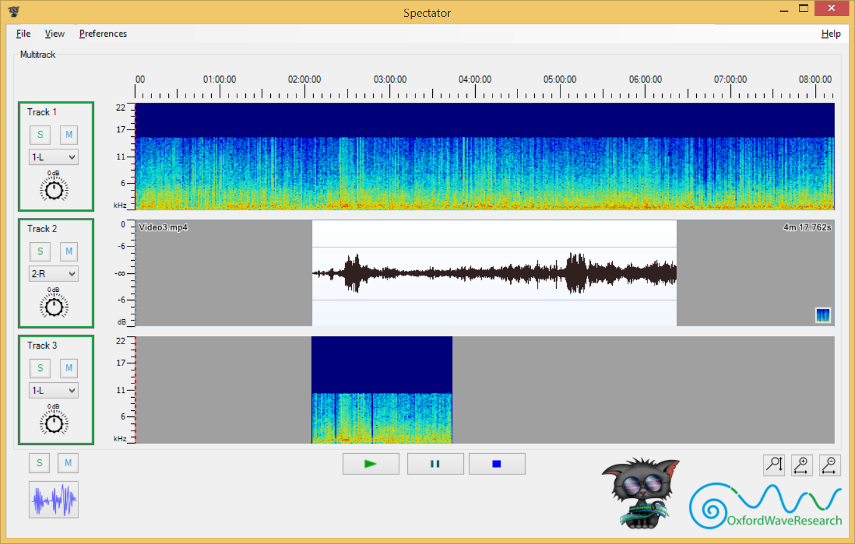
You can toggle all tracks to display between Spectrogram or Waveform mode, toggle them individually and also change the axis scales.

